Slide 1
Delivering a BREAST SCREENING PROGRAMME
June 2019
Tina Summersgill
Breast screening Programme Manager at Bolton, Bury
& Rochdale Breast Screening Programme

Slide 2
Breast Screening
Provides breast screening for GP practices in catchment area (Bolton, Bury and Rochdale).
Invites over 110,000 women for breast screening over a 3 year period.
Invites well women aged 50 – 70 every 3 years
As part of a national age extension trial, women aged between 47- 49 and 71-73 may also be invited.

Slide 3
Breast screening sites
Programmes deliver screening via both Static and/or Mobile units
Bolton One
Radcliffe Primary Care Centre, Bury
Nye Bevan House, Rochdale
Assessment clinics held at
Breast Unit, Royal Bolton Hospital

Slide 4
Prior to screening
Breast Unit writes to GP Practice Managers around 6 weeks prior to planned screening.
Leaflets and posters will be sent to display in the surgery.
The programme requires surgeries to send:
List of women who have had a bilateral mastectomy.
List of women with learning or physical difficulties so an extended appointment can be booked.

Slide 5
Invitation process
All eligible women will be sent a screening invitation letter with an appointment for a specific time and location about 3 weeks before appointment date.
Women can contact the screening unit and change appointment times, dates and location.
There are leaflets available in other languages upon request.
As part of informed consent requirements, the information leaflet Breast screening – Helping you Decide is included with the screening invitation letter.

Slide 6
Screening appointment
Results are sent to women within 2 weeks
Women who DNA are sent a 2nd timed appointment
Practice receive a weekly report of individual patient outcomes

Slide 7
Screening appointment – on the day
Allow about half an hour for an appointment, (actual mammogram takes a few minutes)
Questionnaire
Women are asked about any breast symptoms
Any history of breast disease
Previous imaging
Previous surgery

Slide 8
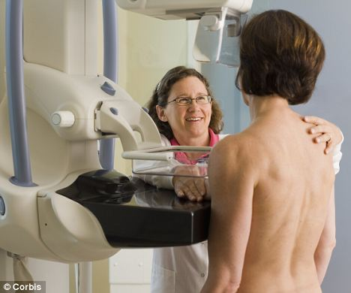
SCREEning appointment - mammogram

Slide 9
Breast Health Awareness
The National Institute for Health and Care Excellence (NICE) advises that being breast aware means:
• knowing what's normal for you
• looking at your breasts and feeling them
• knowing what changes to look for
• reporting any changes to your GP without delay
• attending routine breast screening when eligible

Slide 10
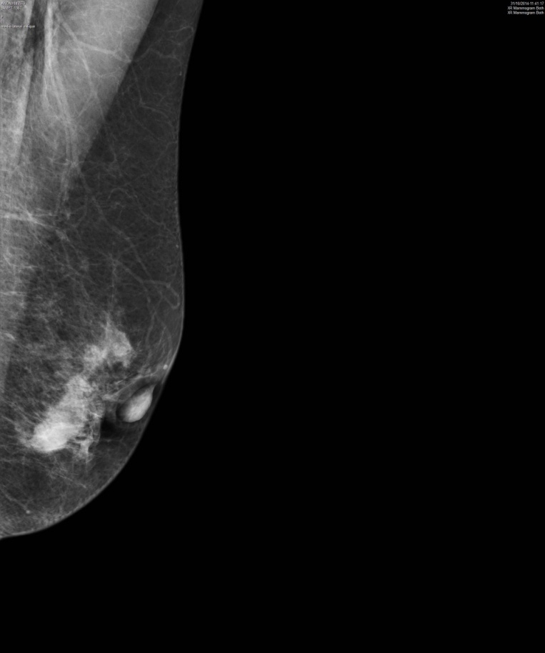
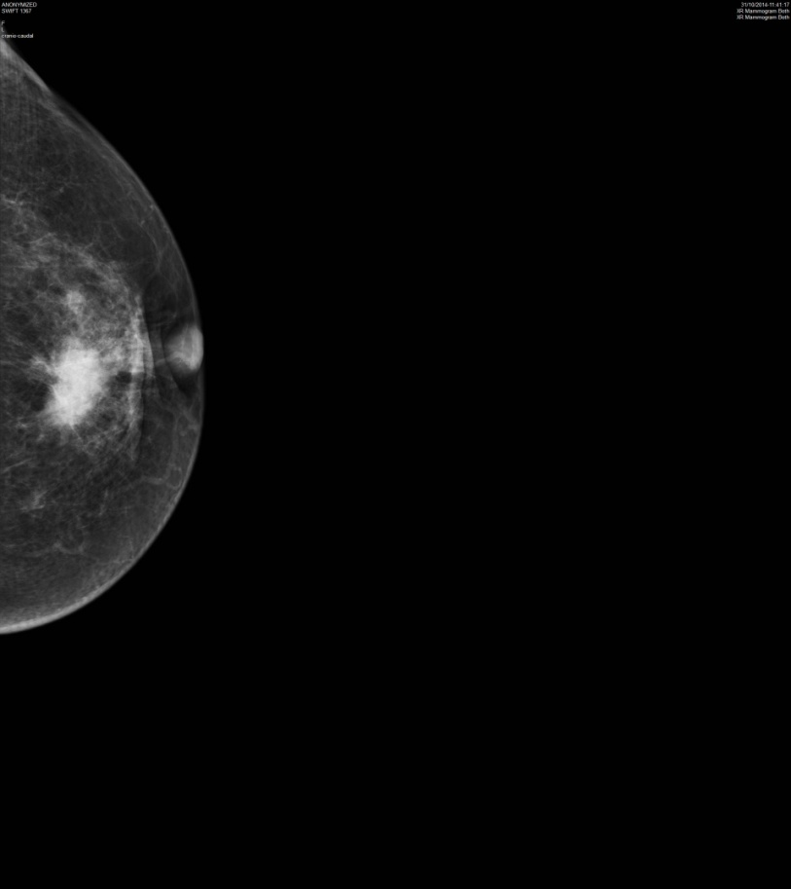
MAMMOGRAMS
PALPABLE CANCER

Slide 11
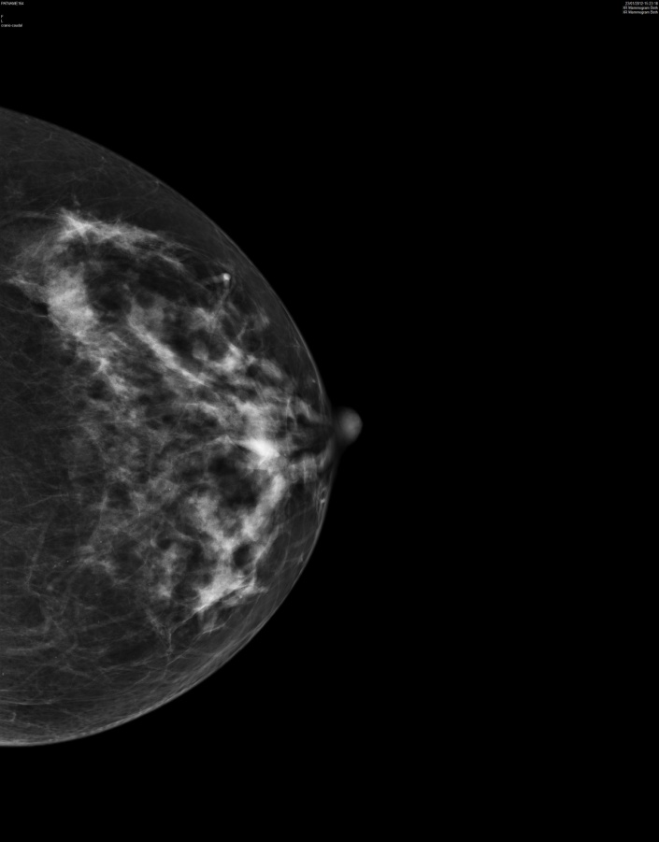
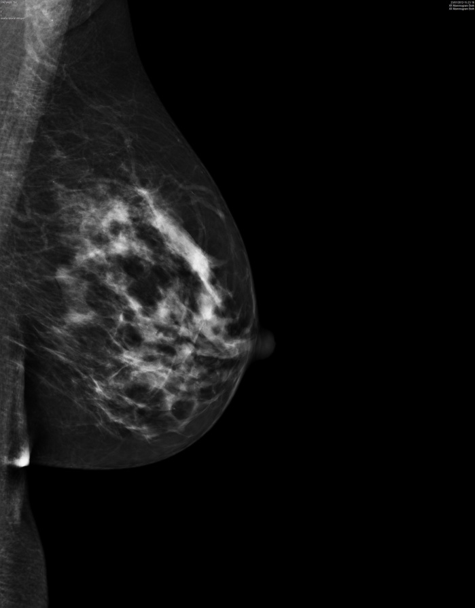
Mammograms
SCREEN-DETECTED CANCER

Slide 12
RESULTS
Mammogram performed
Technical Recall
Results issued within 2 weeks
Abnormal mammograms
Routine recall (3yearly)
Recall to assessment within 3 weeks
U/S extra views +/- bx
Cancer diagnosis refer to surgeons

Slide 13
Barriers to screening
Lost invites/not received/address
changes
Friends had poor experience
Language
Misinformation
Myths / fear / pain
Embarrassment

Slide 14
Ceasing from the BSP
Women should be ceased from the programme if they have had a bilateral mastectomy.
Women have the choice to opt out of the programme permanently. The breast unit will write to the woman requesting her signature of consent to withdraw her. The breast leaflet is also sent to ensure informed decision.
She may re-join the programme at any time by contacting the breast unit.
Declining an appointment at the current time will close the woman's episode but she will be recalled again in 3 years time.

Slide 15
Contact details
www.boltonft.nhs.uk/breast-screening
BSU@boltonft.nhs.uk
Screening Office 01204 390454
Tina Summersgill– Programme Manager 01204 309629
Email Tina.summersgill@boltonft.nhs.uk
Additional information available at https://www.gov.uk/government/collections/breast-screening-professional-guidance

Slide 16
RefERENCES
The benefits and harms of breast cancer screening: an independent review Independent UK Panel on Breast Cancer Screening (2012). The Lancet. 380, No 9855 p1713-1790 e10
NHSBSP (2011) Quality assurance guidelines for breast cancer radiology. 2nd Ed. Sheffield; NHS Cancer Screening Programmes Publication No 59
Public Health England (2017a) NHS Breast Screening Programme Consolidated Standards PHE Publications London
www.agex.uk

Slide 17
Thank you
Any questions

